Slide 1
BE ETHICAL GLOBAL MANAGER: SMILE, CREATE, CARE, HONOR, EXCEL, ACTUALIZE, ADAPT, RESPECT, HELP, DREAM, DARE! By John Thanopoulos
Email: jt@unipi.gr November 29th 2019, Athens, Greece (1st workshop at HSSS Conference, University of Piraeus to be followed by the workshops of Nikos Papazoglou and Depy Caminis)

Slide 2
Applied aspects of management …
Business realities of the last 100 years
Relativity of sizes-eg: (about-in billions $) Greek GNP 200, versus largest global corporation, Wal-Mart 500
Most admired companies
Corporate governance issues
Ethics and business ethics
Others: eg, Happiness=f(material wealth ?)
Managerial self-actualization

Slide 3
“Management's As, Bs, Cs”:
A, stands for self-Actualization (often self-conceptualization).
B, stands for Beyond the above, primarily dealing with the new Information Technology (IT), Artificial Intelligence (AI), Augmented Reality (AR).
C, stands for Centers our attention into Developing appropriate Education for the new societal (not only management) era.

Slide 4
SMILE

Slide 5
Sky is the limit! Try your best!

Slide 6
Make a difference!

Slide 7
Impress to your environment Ethical behaviors

Slide 8
Let’s think global!

Slide 9
Earn respect from everyone!

Slide 10
CREATE

Slide 11
Cultivate a positive attitude

Slide 12
Reach your full potential

Slide 13
Educate yourself, aiming to self-actualize

Slide 14
Appreciate!

Slide 15
Think-out-of-the box

Slide 16
Embrace world-wide opportunities

Slide 17
CARE

Slide 18
Convert experience to service

Slide 19
Actualize your potential

Slide 20
Respect everything!

Slide 21
Encourage self-Education!

Slide 22
HONOR

Slide 23
Hurt no one!

Slide 24
Observe the world from different angles

Slide 25
Thou shalt love thy Neighbor (Leviticus xix 19)

Slide 26
add here the
“ticket without a seat” video
https://www.youtube.com/watch?v=xZEj_a_Gdws

Slide 27
Only move forward

Slide 28
Reinvent plausible positions

Slide 29
…. music from Edith Piaf
"Non, je ne Regrette rien", “

Slide 30
EXCEL

Slide 31
Expert advice (Egotistical thinking)

Slide 32
Xenophobic? Try the opposite!

Slide 33
Cox, Jessica (born without hands, flying a plane, etc)

Slide 34
Encourage appreciation

Slide 35
Life is short … live it to its fullest!

Slide 36
Three CONCEPTS that IMPRESSED YOU MOST ???

Slide 37
ACTUALIZE !

Slide 38
Avoid being a slave

Slide 39
Consistency is a must

Slide 40
Think of successes

Slide 41
Ultimata should be avoided
(this is graffiti!)

Slide 42
Architectural logic
(Cybertecture Egg - Mumbai, India)

Slide 43
Act in a timely manner

Slide 44
Learn to coexist

Slide 45
Invent easy solutions

Slide 46
Zero in to your objective

Slide 47
Evolution

Slide 48
ADAPT!

Slide 49
Adapt to technological evolution

Slide 50
Dare to be emotional

Slide 51
Atomic bomb (be ready for surprises)

Slide 52
Power-Prestige-Payment (3Ps)

Slide 53
Trash self-doubt. … be yourself !

Slide 54
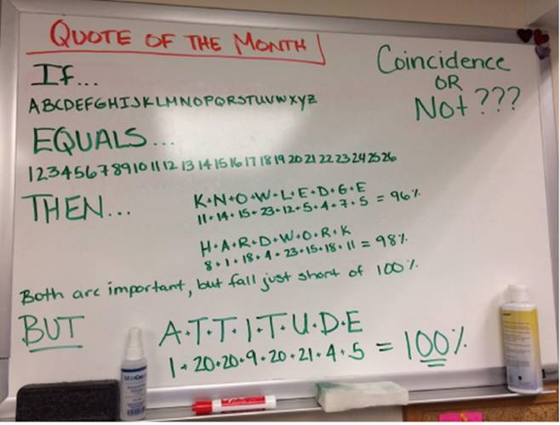
Oh! Again! The main concept behind all these is
ATTITUDE! YOUR ATTITUDE!!!

Slide 55
So, what about … RESPECT, HELP, DREAM, DARE? We will discuss them at another meeting!

Slide 56
Any questions about this part? YOU ARE GREAT!!! Thanks for listening!
John Thanopoulos, Ph.D. (jt@unipi.gr)
Best World Education Congress IB Professor (2012)
HSSS Conference, University of Piraeus November 29th 2019

